Slide 1

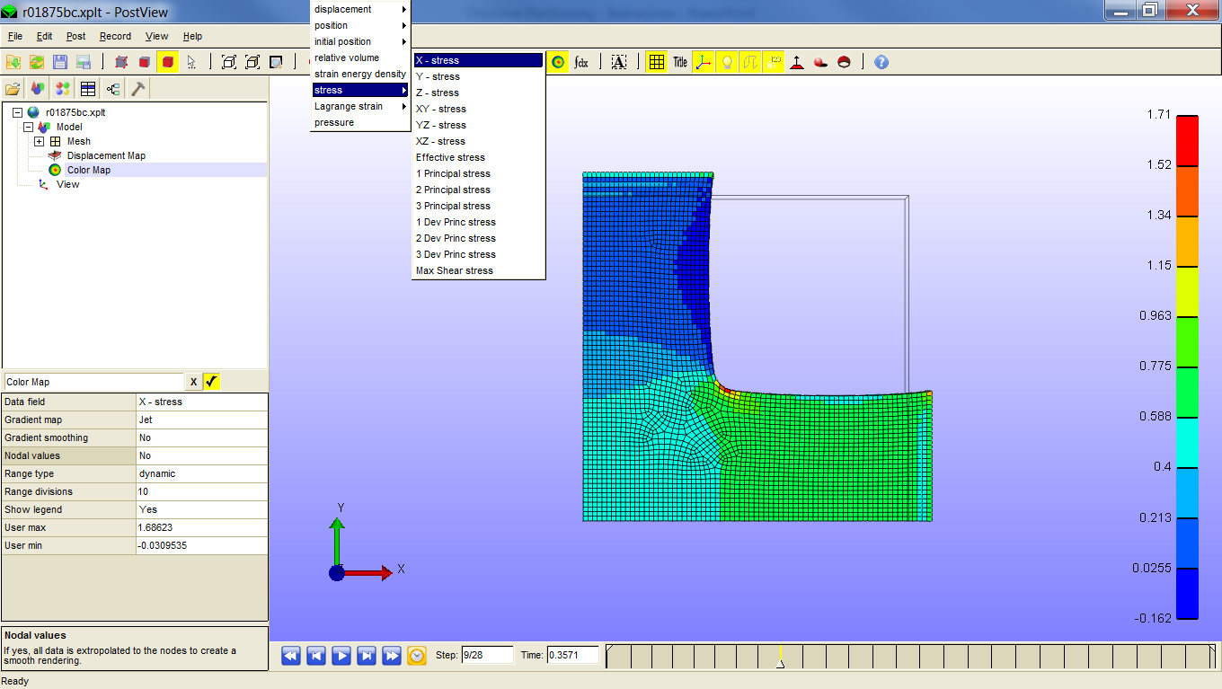
How to implement Objective Partitioning?
1. Export physical data from PostView (.xplt) file
1.1. Select physical property of an interest (e.g. x – stress)

Slide 2
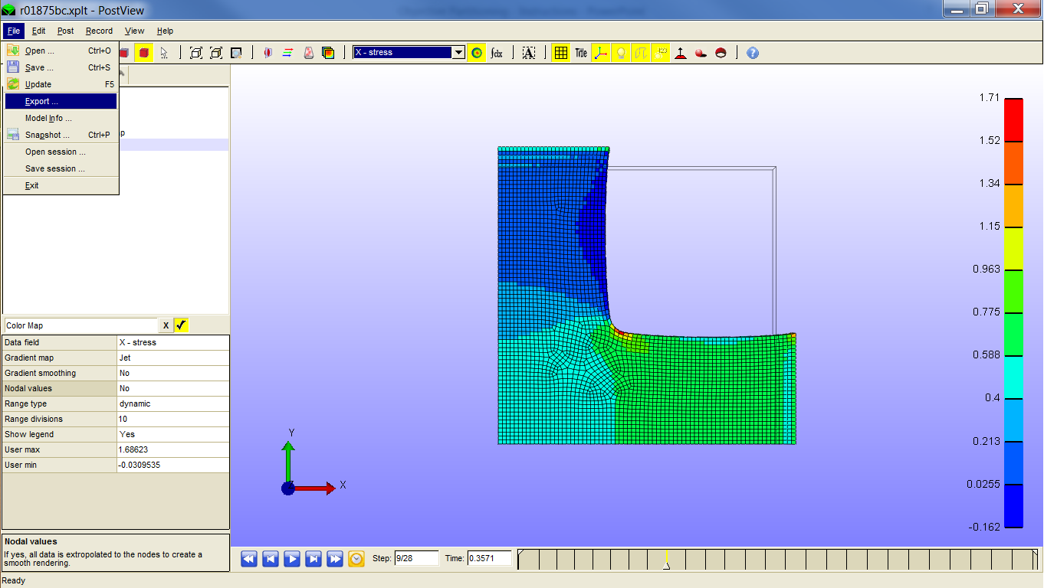
How to implement Objective Partitioning?
1. Export physical data from PostView (.xplt) file
1.2. Export data file

Slide 3
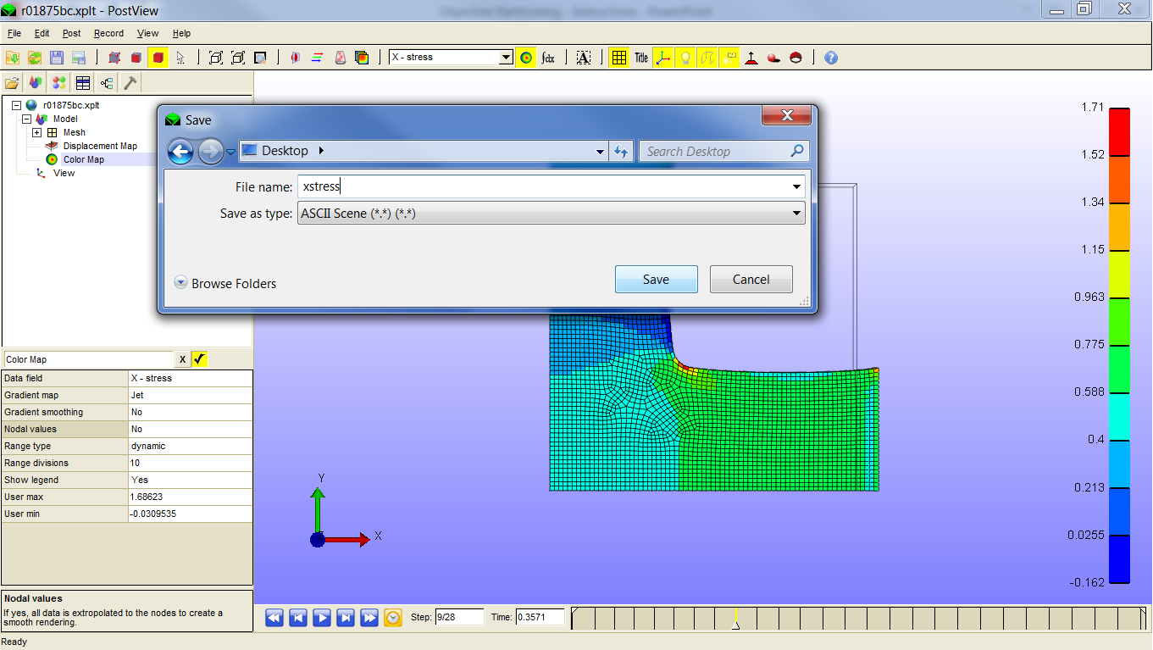
How to implement Objective Partitioning?
1. Export physical data from PostView (.xplt) file
1.3. Save data file as an ASCII extension

Slide 4
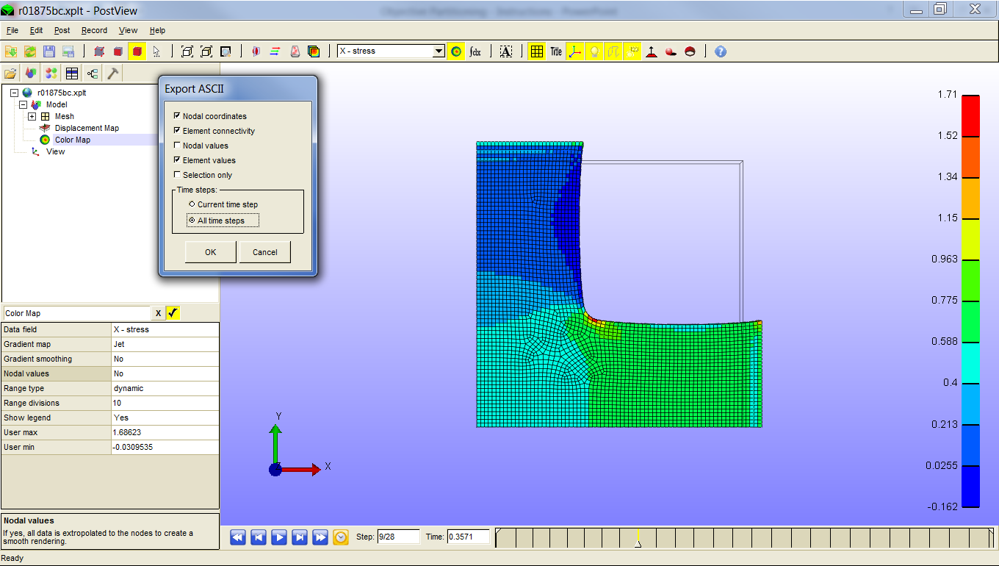
How to implement Objective Partitioning?
1. Export physical data from PostView (.xplt) file
1.4. Save nodal coordinates, element connectivity, and values

Slide 5
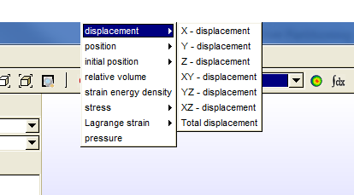
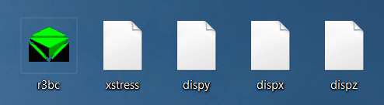
How to implement Objective Partitioning?
1. Export physical data from PostView (.xplt) file
1.5. Save/Export the displacement data
In addition to physical properties of interest, export:
X – displacement
Y – displacement
Z – displacement

Slide 6
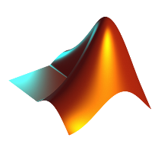

How to implement Objective Partitioning?
2. Compile simulation data using “elementinfo.m”
2.1. Executing code
No inputs are needed as the functions requests data through browser windows
The user may choose a variable name to identify the output structure within the MATLAB® workspace

Slide 7
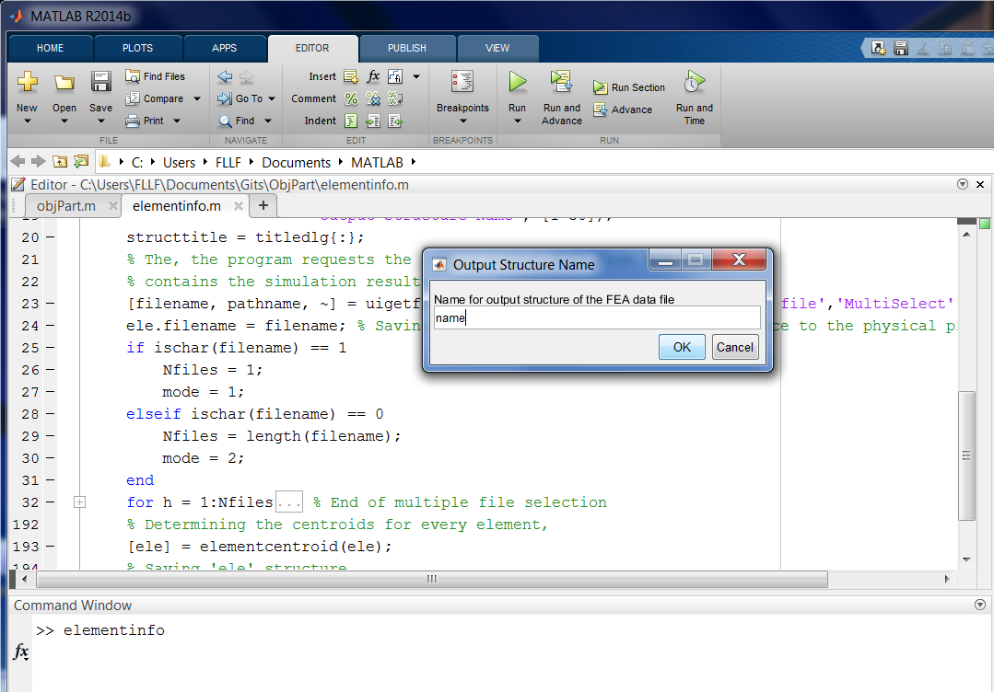
How to implement Objective Partitioning?
2. Compile simulation data using “elementinfo.m”
2.2. Input name for output structure
Structure arrays are used to handle data between and within functions

Slide 8
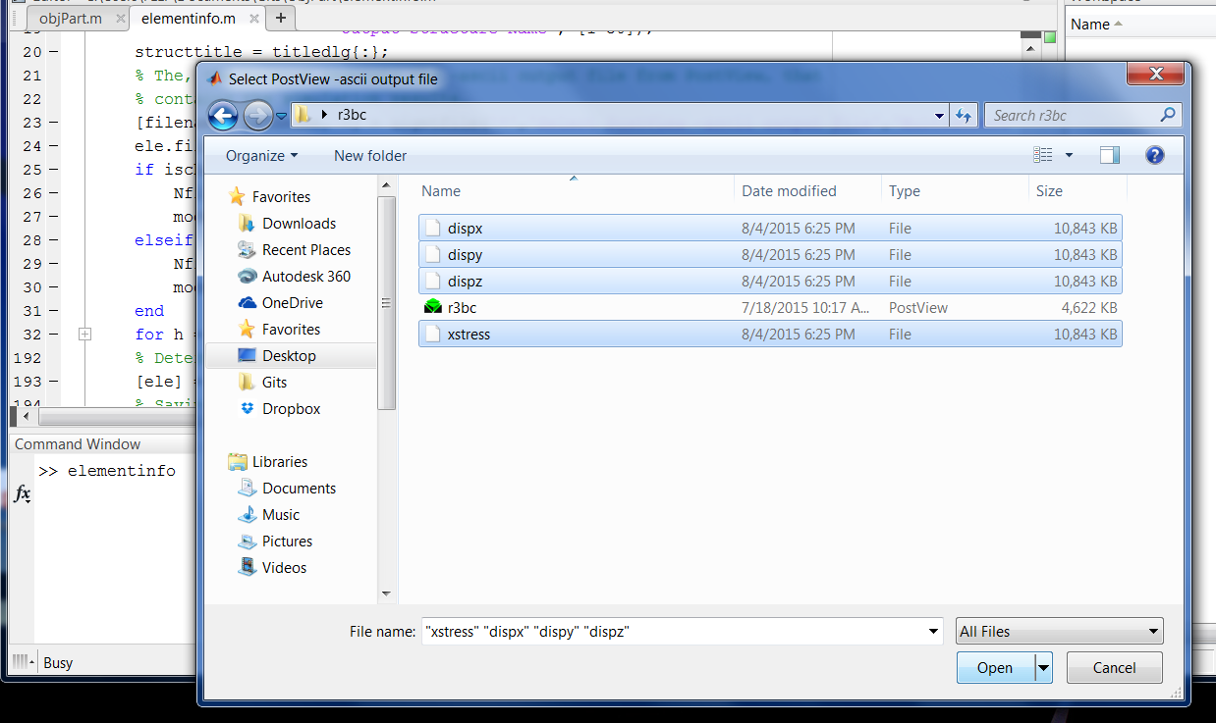
How to implement Objective Partitioning?
2. Compile simulation data using “elementinfo.m”
2.3. Select all the data files needed and those of interest

Slide 9
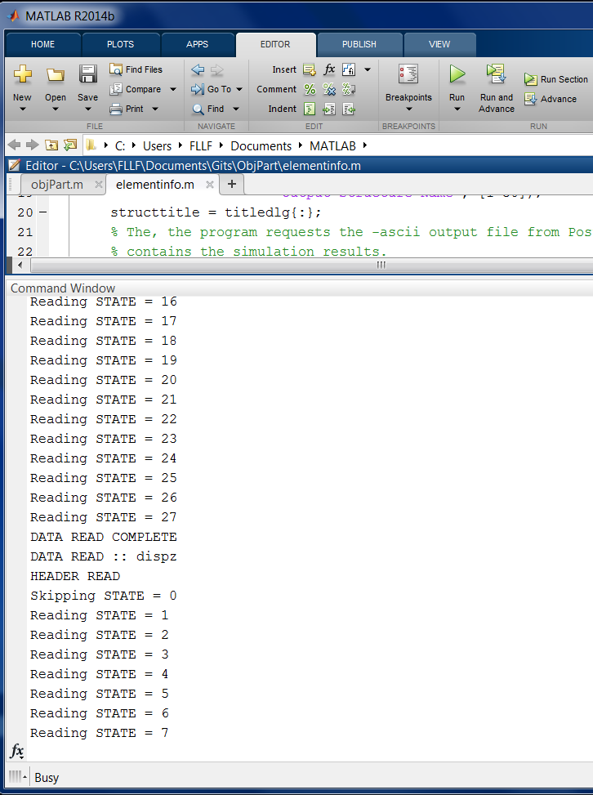
How to implement Objective Partitioning?
2. Compile simulation data using “elementinfo.m”
2.4. Wait for data to be read
Data from each selected file is read in order
Messages in the command window indicate the current file and the simulation time/state

Slide 10
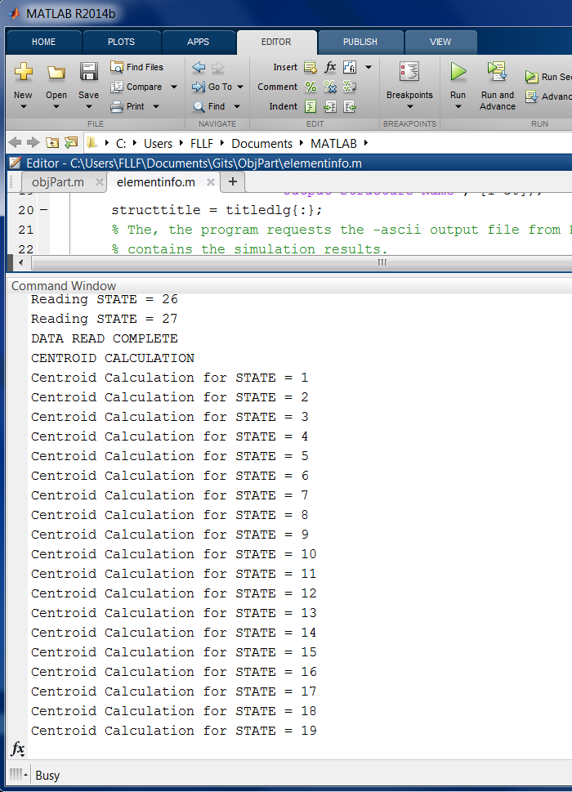
How to implement Objective Partitioning?
2. Compile simulation data using “elementinfo.m”
2.5. Wait for centroid calculation
Centroid calculation is an additional task that prolongs the read process

Slide 11
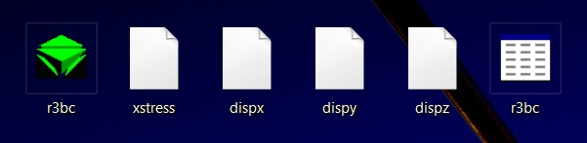
How to implement Objective Partitioning?
2. Compile simulation data using “elementinfo.m”
2.6. Identify output
Data files (ASCII exports)
Structure Array from “elementinfo.m”
PostView file
File saved in the directory of inputs

Slide 12
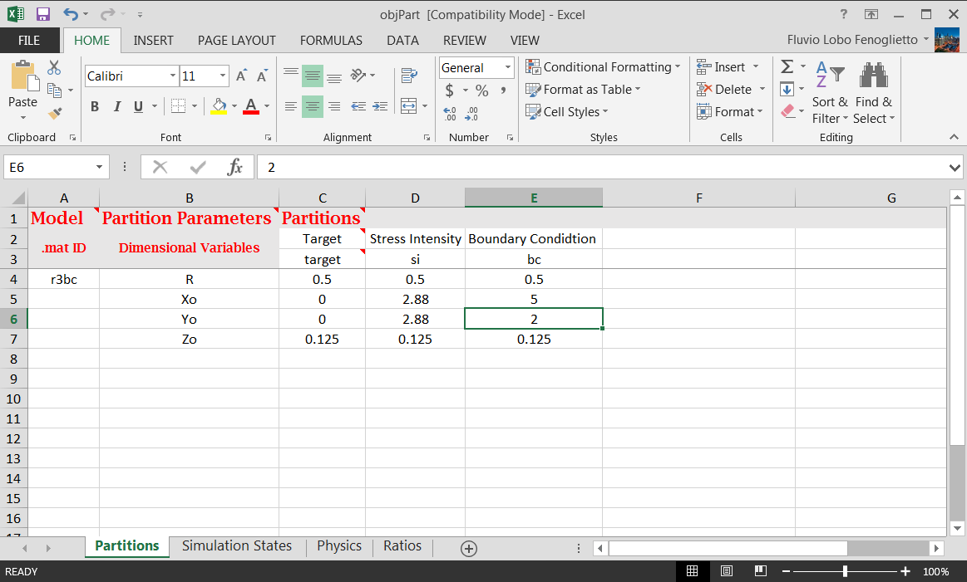
How to implement Objective Partitioning?
3. Performing Objective Partitioning through “objPart.m”
3.1. Preparing input
Objective Partitioning takes place through an excel-based interface.
Each sheet within the “objPart.xls” relates to a specific setting or configuration of the analysis method

Slide 13
How to implement Objective Partitioning?
3. Performing Objective Partitioning through “objPart.m”
3.1.1. Defining Partitions
Objective Partitions, as of now, are defined by spheres of radius R and located at an origin of interest (Xo, Yo, Zo)
The user may specify any number of partitions. All of which must have a name and dimensions
The user must identify the name of the associated structure array

Slide 14
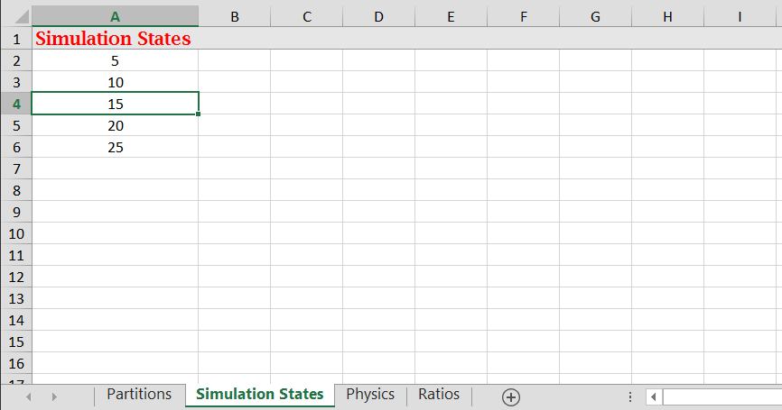
How to implement Objective Partitioning?
3. Performing Objective Partitioning through “objPart.m”
3.1.2. Specifying Simulation States
In the Simulation States sheet, the user can specify the time points were the analysis is necessary.

Slide 15
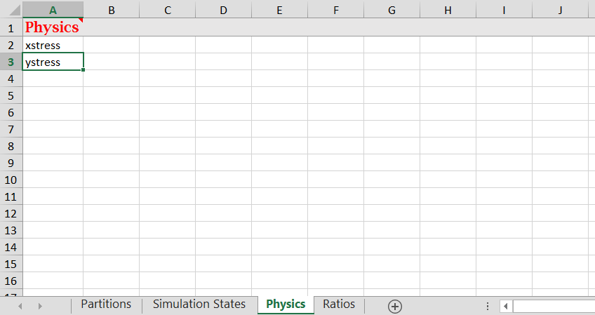
How to implement Objective Partitioning?
3. Performing Objective Partitioning through “objPart.m”
3.1.3. Selecting Physics
In the Physics sheet, the user specifies the physical data on which to perform the analysis

Slide 16
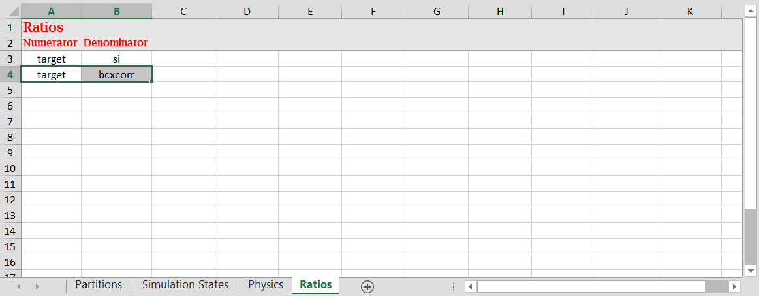
How to implement Objective Partitioning?
3. Performing Objective Partitioning through “objPart.m”
3.1.4. Ratios
In the Ratios sheet, the user can define ratios to be calculated between the means of each objective partition.
The user must use the identifier of the partitions for the code to discern numerator from denominator

Slide 17
How to implement Objective Partitioning?
3. Performing Objective Partitioning through “objPart.m”
3.1.5. Warning!!
All sheets covered between sections 3.1.1. and 3.1.4. must have at least one input. Otherwise, the whole program wont work!!

Slide 18
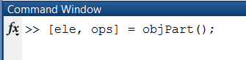
How to implement Objective Partitioning?
3. Performing Objective Partitioning through “objPart.m”
3.2. Executing code
No inputs are needed as the functions requests data through browser windows
The program modifies and outputs the structure array created by “elementinfo.m”
The variable “ops” contains the information that defines the objective partitions

Slide 19
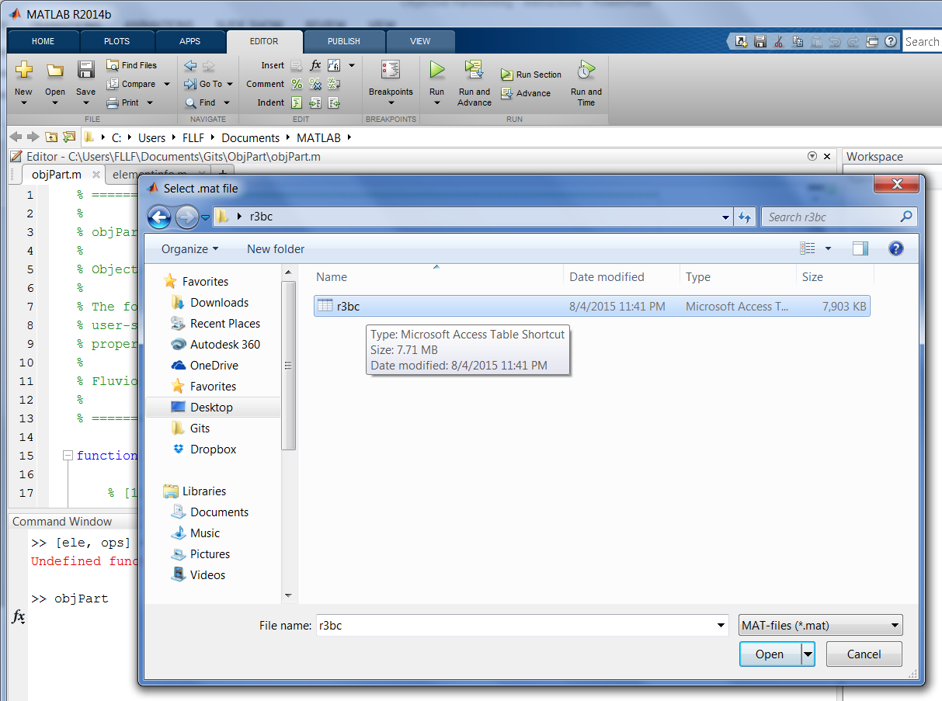
How to implement Objective Partitioning?
3. Performing Objective Partitioning through “ObjPart.m”
3.3. Browse for data structure array “ele”

Slide 20
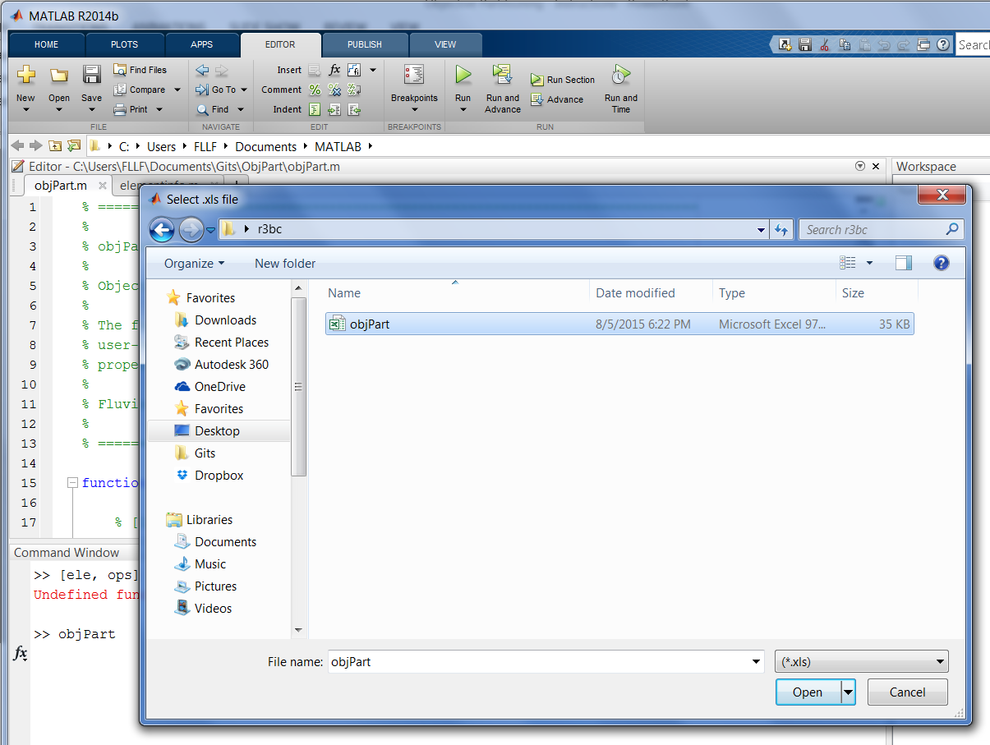
How to implement Objective Partitioning?
3. Performing Objective Partitioning through “ObjPart.m”
3.4. Browse for “objPart.xls”

Slide 21
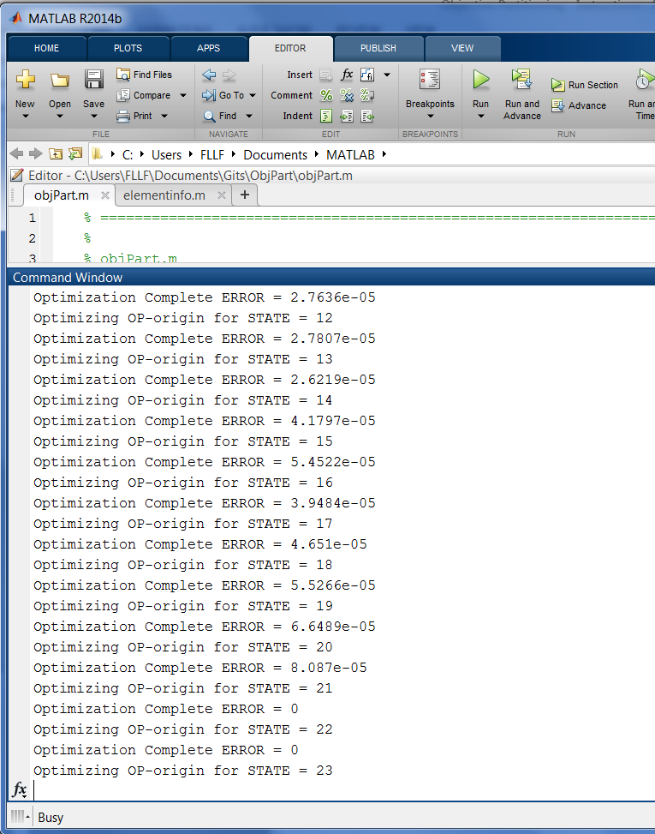
How to implement Objective Partitioning?
3. Performing Objective Partitioning through “ObjPart.m”
3.5. Wait for optimizations to complete
Most of the computations in objective partitioning are associated with the relocation of the partitions on the basis of the deformation of the target mesh

Slide 22
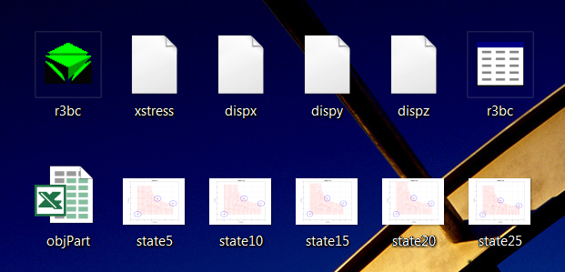
How to implement Objective Partitioning?
3. Performing Objective Partitioning through “ObjPart.m”
3.5. Identify outputs
Structure Array from “elementinfo.m” has been updated!
Output figures for visualization
objPart.xls
File saved in the directory of inputs

